Slide 1

How to raise money from VC as an early-stage Founder
Noah Lee 1752vc Venture Scout
‹#›

Slide 2
Contents
Background & Motivation.
Basic Investment Thesis
Pitch Communication
Mindset
10-min Break
Speech Preparation
Speech & Real-Time Feedback
‹#›

Slide 3

Background & Motivation
When sourcing deals to VC, I see same Problem with pattern.
Pitch Communication
Basic Investment Thesis
Mindset
Pick, Best Corporate Events, workplace-unhappiness (2023)
Ellison, Built In, avoid-common-investor-pitch-pitfalls (2024)
Teten & Nasser, TechCrunch, investment-thesis-or-hypothesis (2021)
Menn, TechCrunch, three-human-mistakes-vcs-make (2023)
‹#›

Slide 4

Background & Motivation
Goal: Early-Stage Founders to get Fundraise easily.
VCs want to invest on a Startup.
If knowing what most startups are missing in VCs’ perspective, better chance at fundraising!
Kumar, Startup Talky, pitch-mistakes (2021)
Spectup, spectup Resource Hub, vc-expectations-2025-founders-missing (2025)
‹#›

Slide 5
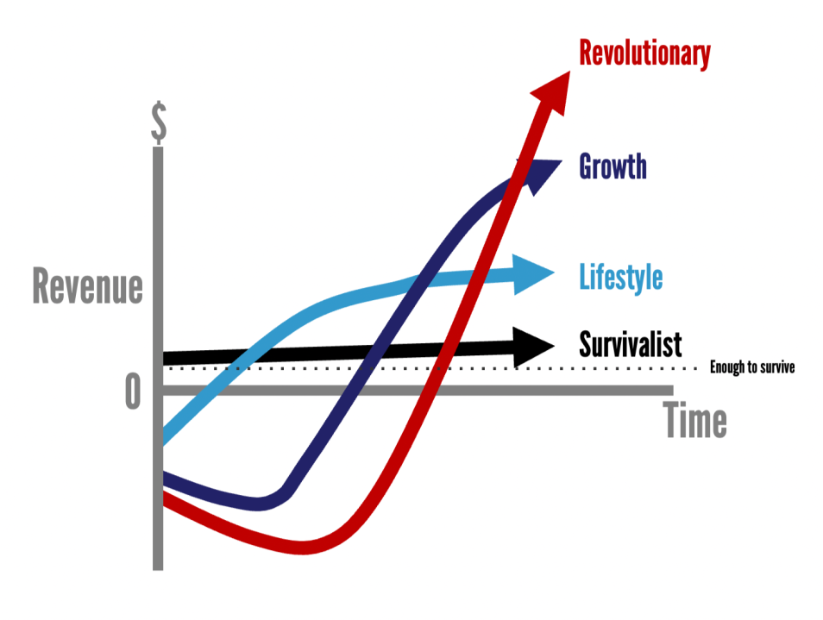
II. Basic Investment Thesis: Power Law Startup
Does your Startup actually require money from VC?
Is it a Lifestyle Business?
Does it go through the Power Law?
Can you actually dominate an industry?
Fisher, Medium, 963ac72227ba (2021)
Rachitsky, Lenny’s Newsletter, venture-scale-idea (2023)
‹#›

Slide 6

II. Basic Investment Thesis: Know in Detail
Are you serious about actually starting this company? Do you know your
Units/Price?
Adoption Path?
Cash Runway & Burn Rate?
Customer Validation?
Co-Founder Equity Vesting?
Oakmont Capital Services, Oakmont Capital Services, three-finance-professionals (2025)
Content, Haven, startup-finance-basics (2026)
Digital Marketing, Basel Area Business & Innovation, 6-stages-startup (2026)
Donohoe, The Wealth Standard, mike-moyer-slicing-pie (2019)
‹#›

Slide 7
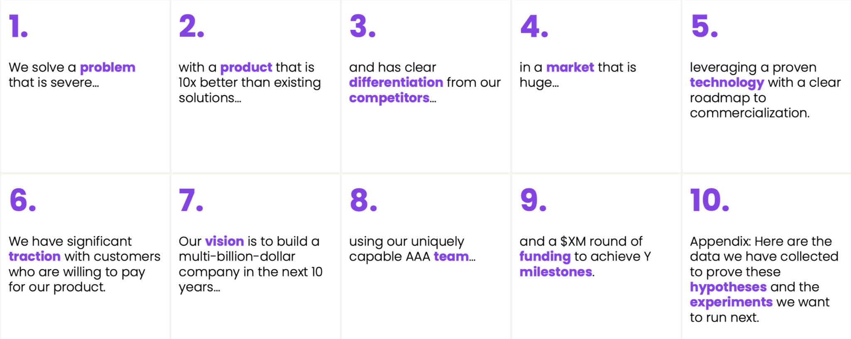
III. Pitch Communication: Slide Deck Framework
Drumbeat Capital, Drumbeat Capital, home (n.d.)
‹#›

Slide 8

III. Pitch Communication: Short Articulation
Can you articulate your Startup in 2 minutes?
What the Company does?
Who it’s for?
Why now?
Giordano, StaffedUp, unique-abilities (2026)
Legler, GoingVC, effective-elevator-pitch (2025)
‹#›

Slide 9

IV. Mindset: Mental Framework
Don’t be nervous. Venture Capitalists are just normal human being who want to talk.
They also feel happy, sad, fear, hungry, and have normal daylife like you. You’re just talking to another human-being.
University of Pennsylvania, Phys.org, 2019-08-society-cultural-social-networks (2019)
‹#›

Slide 10
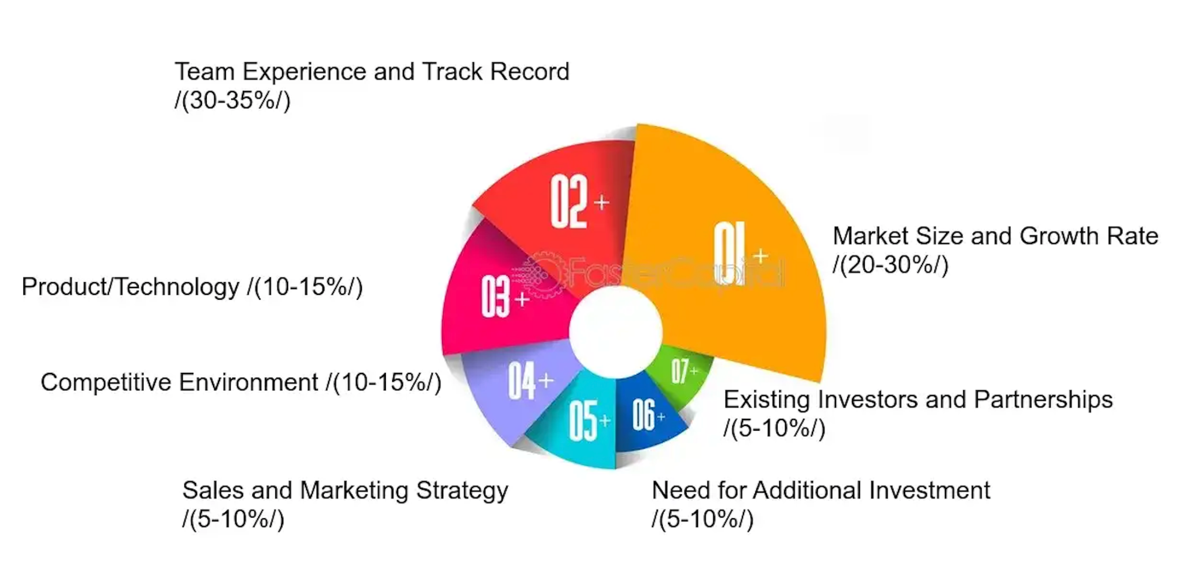
IV. Short Tips: Increase Valuation without Revenue
Team quality and market size value.
Make real prototype or MVP.
Comparable reality check.
Documentation (Methodology, supporting idea, transparent logic)
FasterCapital, FasterCapital, ecommerce-inventory-management-efficient (2025)
Gregory, Flippa, value-startup-no-revenue-5-steps (2026)
‹#›

Slide 11

V. 10-min Break
Lowe, Loving Life, breaks-at-work-productivity (2025)
‹#›

Slide 12
V. Speech Preparation
Make a framework of your Pitch Deck.
Able to Articulate your business in 2 minutes.
University of Pennsylvania, Phys.org, 2019-08-society-cultural-social-networks (2019)
‹#›

Slide 13

VII. Speech & Real-Time Feedback
Pitch Deck Overview
Or
2 Minutes Pitch
Feedback from Audience (Short notes and write down on a piece of paper)
Birt, Indeed Career Guide, how-to-memorize-speech (2026)
‹#›

